Slide 1
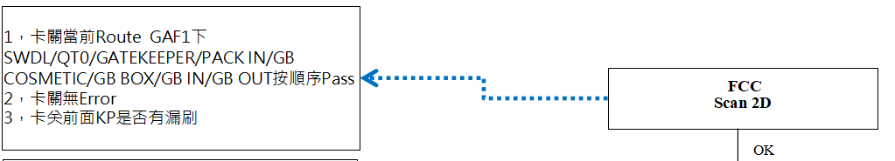
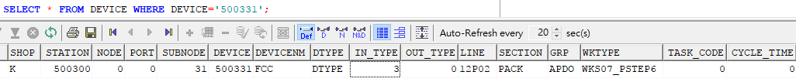
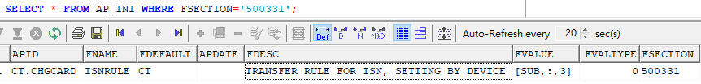
FCC（检查机台外观是否完好）
（Check the appearance of the machine）
1.GRP: APDO
2.刷法(Brush method)： 2D ISN (DEVICE.INTYPE=3; AP_INI.FVALUE=[SUB,:,3] 表示截取2D中第二到第三个冒号中的信息为REAL ISN(It means to intercept the information in the second to third colons in 2D as isn))

Slide 2
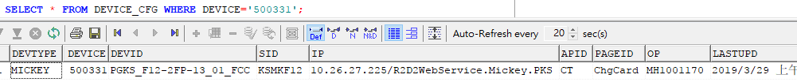
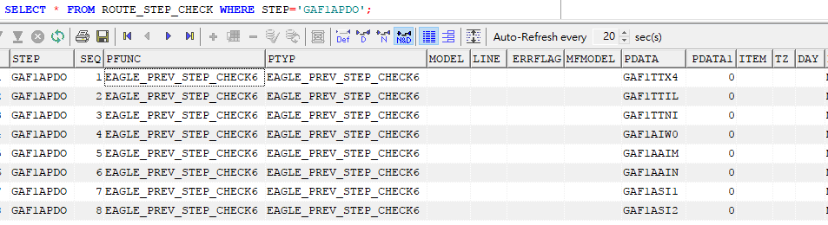
3.站位卡关（Station card off）
SELECT * FROM ROUTE_STEP_CHECK WHERE STEP='GAF1APDO';

Slide 3
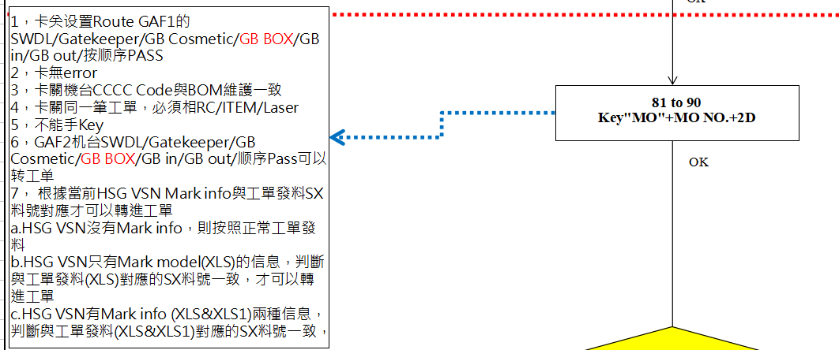
1.81 to 90（将机台从81工单转到90工单）
（Transfer machine from 81 MO to 90 MO）
1.GRP:A10
2.2.刷法(Brush method)： Key"MO"+MO NO.+2D ISN (DEVICE.INTYPE=3;AP_INI.FVALUE=[SUB,:,3] 表示截取2D中第二到第三个冒号中的信息为REAL ISN(It means to intercept the information in the second to third colons in 2D as isn))

Slide 4
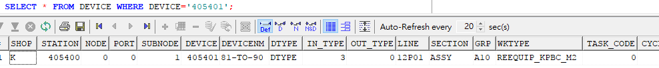
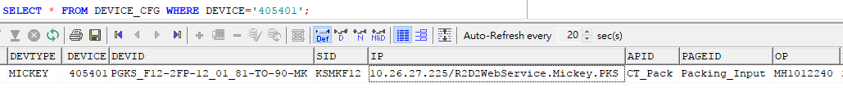
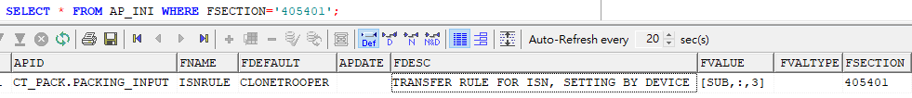
3.站位卡关（Station card off）
SELECT * FROM ROUTE_STEP_CHECK WHERE STEP='GAP1AA10';

Slide 5
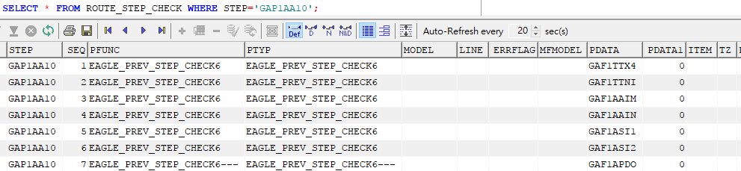
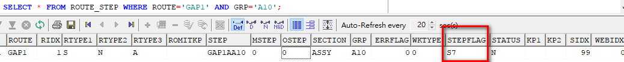
過STEP這站時，卡要有PDATA中的過站記錄（When passing the step station, the card should have the station passing record in pdata）
4.站位设定(Station setting)
SELECT * FROM ROUTE_STEP WHERE ROUTE='GAP1' AND GRP='A10';（投入站（input station），RTYPE1=S，STEPFLAG=S7，是投入站的固定配置（It is the fixed configuration of the input station））

Slide 6
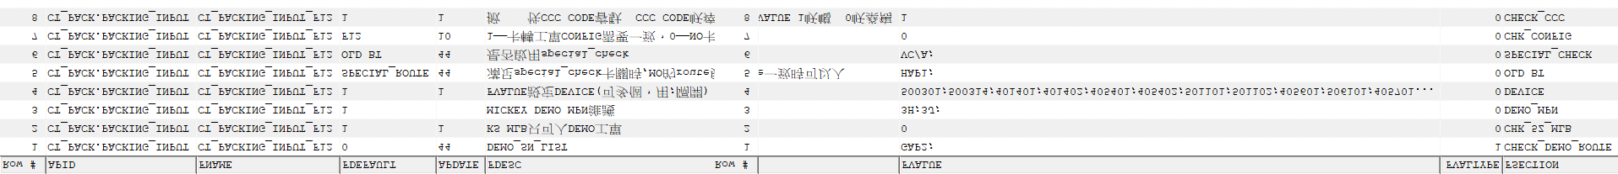

5.程式页面卡关(Program page blocking)
具体卡关请参考附件（Please refer to the attachment for details）

Slide 7
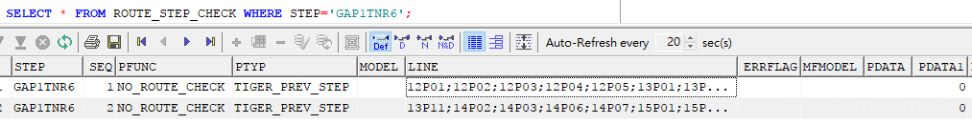
2.QT6（测试站）
(TEST STATION)
1.GRP: NR6
2.站位卡关（Station card off）
SELECT * FROM ROUTE_STEP_CHECK WHERE STEP='GAP1TNR6';
NO_ROUTE_CHECK
不卡節點，可以無限測試，一般用於回流線
（It can be used for infinite test, and is generally used for return line）

Slide 8
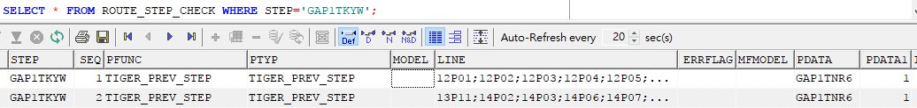
3.QT5（测试站）
(TEST STATION)
1.GRP: KYW
2.站位卡关（Station card off）
TIGER_PREV_STEP
測試站卡測試站，前面的測試站沒有做，後面的測試就會被卡住，報錯;（不会卡过站顺序，只要有过站记录就可以了）
Test station card test station, the front of the test station did not do, the back of the test will be stuck, error（ I don't want to get stuck in the station crossing sequence, as long as there are station crossing records.)

Slide 9
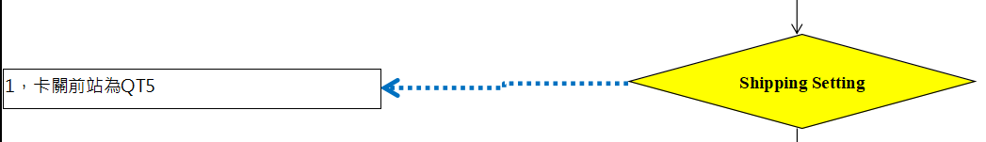
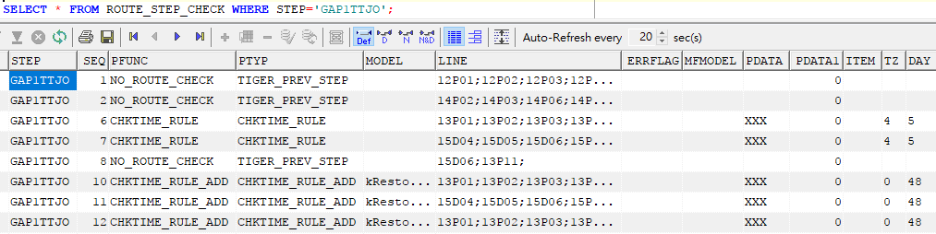
4.SHIPPING SETTING（测试站）
(TEST STATION)
1.GRP: TJO
2.站位卡关（Station card off）
SELECT * FROM ROUTE_STEP_CHECK WHERE STEP='GAP1TTJO';

Slide 10
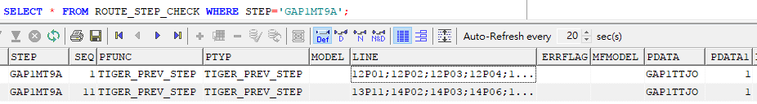
5.LASER SIM TRAY（测试站）
(TEST STATION)
1.GRP: MT9A
2.站位卡关（Station card off）
SELECT * FROM ROUTE_STEP_CHECK WHERE STEP='GAP1MT9A';

Slide 11
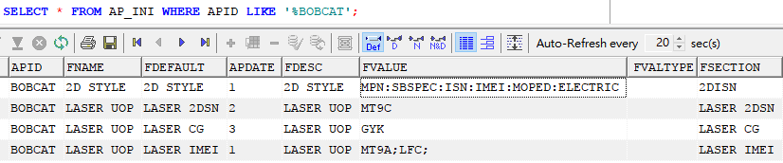
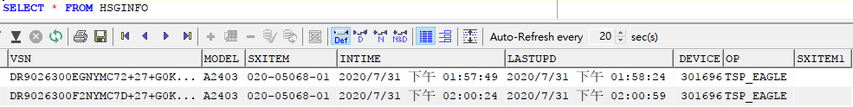
3.程式维护(Program maintain)
SELECT * FROM AP_INI WHERE APID LIKE '%BOBCAT'; (维护镭雕时需要check UOP的站位（Check the UOP station when maintaining radium carving）)
4.程式抓值(Program capture value)
KPBC为XLS，镭雕完后，镭雕相关信息存入 HSGINFO、HSGINFO_AU两张表中（After the laser carving, laser carving related information in HSGINFO, HSGINFO_AU two tables）

Slide 12
VSN:
SELECT SUBSTR(TAGDATA,4,LENGTH(TAGDATA)-4) FROM MOKP_D WHERE ISN='FFMDD23W0F12' AND KPBC='LD1';
MODEL：
当CUSTITEM是993-开头，抓ISN的ITEM对应MODEL_D维护的MODEL
(When CUSTITEM is 993 - at the beginning, the ITEM ISN corresponding MODEL_D maintenance MODEL)
SELECT ATTRINFO FROM MODEL_D WHERE MODELID IN(SELECT ITEM FROM ISN WHERE ISN='FFMD501M04D0') AND ATTRID='MODEL';
当CUSTITEM不是993-开头，抓ISN的ITEM对应MODEL_D维护的MODEL
（When CUSTITEM not 993 - at the beginning, the ITEM ISN corresponding MODEL_D maintenance MODEL）
SELECT ATTRINFO FROM MODEL_D WHERE MODELID IN(SELECT CUSTITEM FROM ITEM_IBQ_CUST WHERE ITEM IN(SELECT ITEM FROM ISN WHERE ISN='FFMDD23W0F12')) AND ATTRID='MODEL';

Slide 13
SXITEM:
1.首先判斷是否有發SX料號，有值的話直接塞ITEMSP(First of all, judge whether there is SX item number, if there is a value, directly plug it into itemsp)
SELECT ITEMSP FROM ITEM WHERE ITEM IN (SELECT ITEM FROM MO_ITEM WHERE MO IN (SELECT MO FROM ISN WHERE ISN = 'C7JPH0JVGKW8') AND ITEM LIKE 'SX%');
2.如果上面的句子返回為空，則繼續判斷，看是否有BY ARTWORK_TYPE維護的，如果有，直接調用ATTRINFO的鐳雕版本(If the above sentence is empty, continue to judge to see if there is by arrow_ Type maintenance, if any, directly call the radium version of attrinfo)
SELECT ATTRINFO FROM MODEL_D WHERE MODELID = 'ARTWORK_TYPE' AND ATTRID IN (SELECT ITEM FROM ISN WHERE ISN = 'C7JNF033G9D3');
3.如果2沒有值，則繼續判斷，是否有BY CONFIG維護，如果有直接調用(If 2 has no value, continue to judge whether there is by config maintenance. If there is, call it directly)
SELECT attrinfo FROM model_d WHERE modelid = 'ARTWORK_TYPE' AND attrid IN (SELECT SUBSTR (b.s, INSTR (b.s,'/',1,3)+ 1, INSTR (b.s,'/',1,4)- INSTR (b.s,'/',1,3)- 1)FROM (SELECT (SELECT sn1 FROM isninfo WHERE isn = 'C7JNW0DXGFC5')s FROM DUAL) b);

Slide 14
UOP判断：
QUERY p=unit_process_check,看MO_ROUTE中有无MT9A的PASS记录，如果有，那unit_process_check=SKIP ETCH,如果无，那unit_process_check=LASER:123

Slide 15
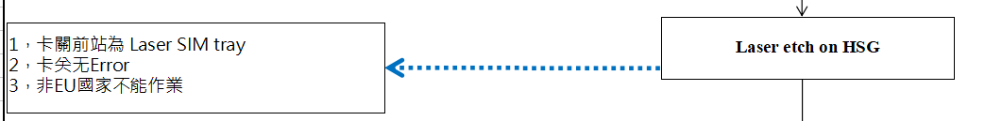
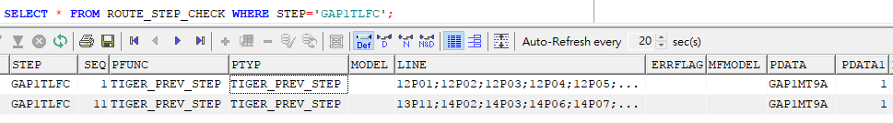
6.Laser etch on HSG（测试站）
(TEST STATION)
1.GRP: LFC
2.站位卡关（Station card off）
SELECT * FROM ROUTE_STEP_CHECK WHERE STEP='GAP1TLFC';
3.只有欧洲国家需要（ONLY for EU county）

Slide 16
3.程式维护(Program maintain)
SELECT * FROM AP_INI WHERE APID LIKE '%BOBCAT'; (维护镭雕时需要check UOP的站位（Check the UOP station when maintaining radium carving）)
4.程式抓值(Program capture value)
KPBC为XLS1，镭雕完后，镭雕相关信息存入 HSGINFO、HSGINFO_AU两张表中（After the laser carving, laser carving related information in HSGINFO, HSGINFO_AU two tables）

Slide 17
SXITEM1:
判斷是否有發KPBC为XLS1的料，有值的話直接塞ITEMSP(Determine whether there is a hair KPBC XLS1 material, have the value directly ITEMSP)
SELECT ITEMSP FROM ITEM WHERE ITEM IN (SELECT ITEM FROM MO_ITEM WHERE MO IN (SELECT MO FROM ISN WHERE ISN = 'C7JPH0JVGKW8') AND KPBC='XLS1');
UOP判断：
QUERY p=unit_process_check,QUERY UOP是用tsid参数(以AE-36結尾),看HSGINFO_AU与HSGINFO中SXITEM1有无填值，如果有填值，那unit_process_check=SKIP ETCH,如果无填值，那unit_process_check=OK
UOP judgment:
QUERY p=unit_process_check, QUERY UOP uses tsid parameter (End with AE-36) to check whether there are values in HSGINFO_AU and HSGINFO table, if there are values, then unit_process_check=SKIP ETCH, if no , then unit_process_check=OK

Slide 18
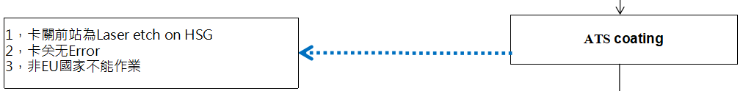
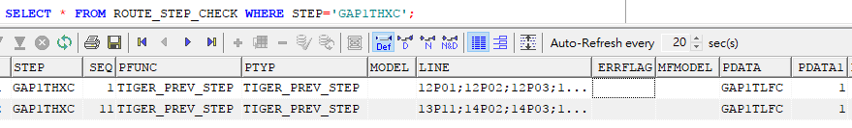
7.ATS coating（测试站）
(TEST STATION)
1.GRP: HXC
2.站位卡关（Station card off）
SELECT * FROM ROUTE_STEP_CHECK WHERE STEP='GAP1THXC';
3.只有欧洲国家需要（ONLY for EU county）

Slide 19
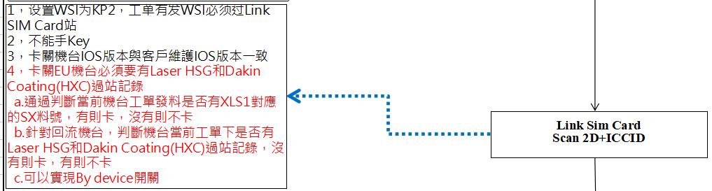
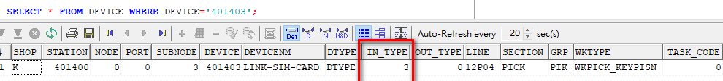
8.LINK SIM CARD（link SIM卡）
（link SIM card）
1.GRP: PIK
2.刷法(Brush method)： 2D ISN (DEVICE.INTYPE=3)

Slide 20
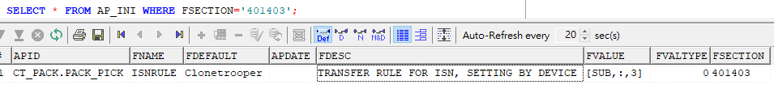
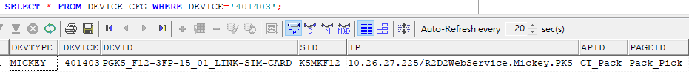
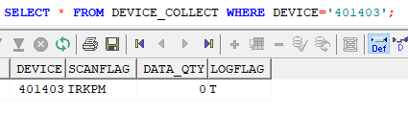
I:ISN先刷找DB, Multi DB模式(ISN brush for DB first, Multi DB mode)
R:將ISN所在SID的DEVINFO COPY回DEVICE所在的SID(Return the device copy of the SID of the ISN to the SID of the device)
K:代表該DEVICE為KP LINK站(On behalf of the device as KP link station)
P:代表需要顯示圖片(Representatives need to display pictures)
M:代表需要check MARINA(Rep needs check Marina)

Slide 21
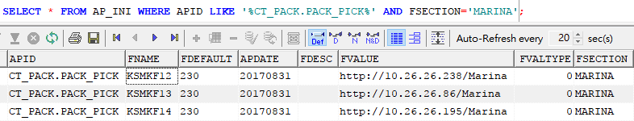
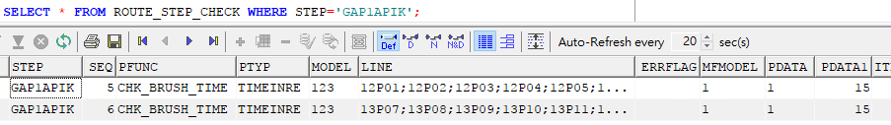
MARINA卡关，通过ISN去query客户的MARINA service，判断机台能否出货，URL如下：（The marina card is closed, and the customer's Marina service is queried through isn to judge whether the machine can be delivered，URL as follows：）
3.站位卡关（Station card off）
SELECT * FROM ROUTE_STEP_CHECK WHERE STEP='GAP1AA10';

Slide 22
时间卡关，MODEL栏位固定为123，当机台过STEP站位时，判断当前站位时间最大的一笔过站记录的时间，与当前系统时间的差值是否小于PDATA1维护的时间，如果小于则报错（PDATA1為時間，秒）
(The time card is off, and the field of model is fixed as 123. When the machine passes the step station, it will judge whether the difference between the time recorded in the current station and the current system time is less than the time of pdata1 maintenance. If it is less than, an error will be reported (pdata1 is the time, seconds))

Slide 23
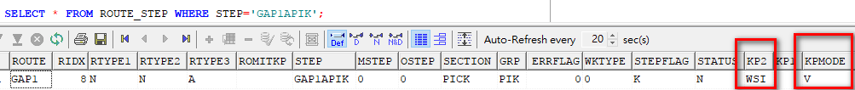
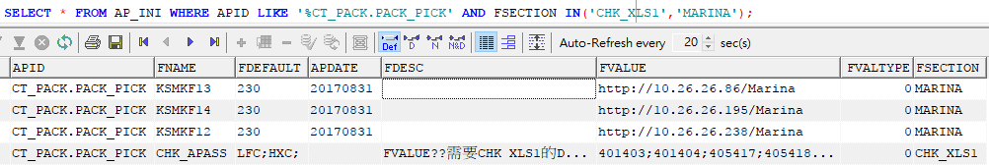

5.站位设定(Station setting)
SELECT * FROM ROUTE_STEP_CHECK WHERE STEP='GAP1APIK';
(ROUTE_STEP.KP2=WSI KPMODE=V)
6.程式页面卡关(Program page blocking)
具体卡关请参考附件（Please refer to the attachment for details）

Slide 24
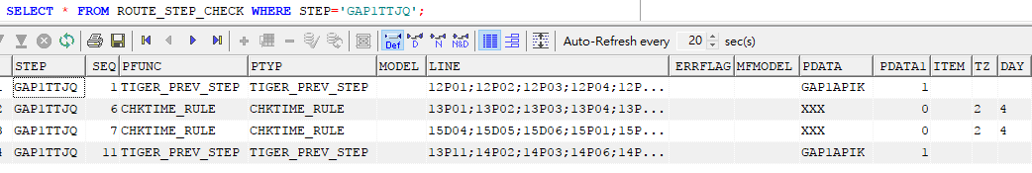
9.I CHECK（测试站）
(TEST STATION)
1.GRP: TJQ
2.站位卡关（Station card off）
SELECT * FROM ROUTE_STEP WHERE STEP='GAP1TTJQ';

Slide 25
CHKTIME_RULE
超時卡關，在STEP站位測試FAIL之後，第二次重新測試時，測試時間減去第一次測試過站的時間，時間差大於維護的時間，則報錯（TZ為分鐘，DAY為小時）
If the time-out card is off, after the step station fails the test, the test time minus the time of the first test, and the time difference is greater than the maintenance time, an error will be reported (TZ is minutes, day is hours)
CHKTIME_RULE_ADD
超時卡關，當STEP站位UOP超時時，如果MODEL欄位有維護FAIL_MESSAGE，則按照該維護的
新時間卡關（DAY為時間，小時）
(The timeout card is off. When the UOP of the step station exceeds the limit, if the maintenance fails in the model field_ Message, it is maintained according to the
New time card off (day is time, hour))

Slide 26
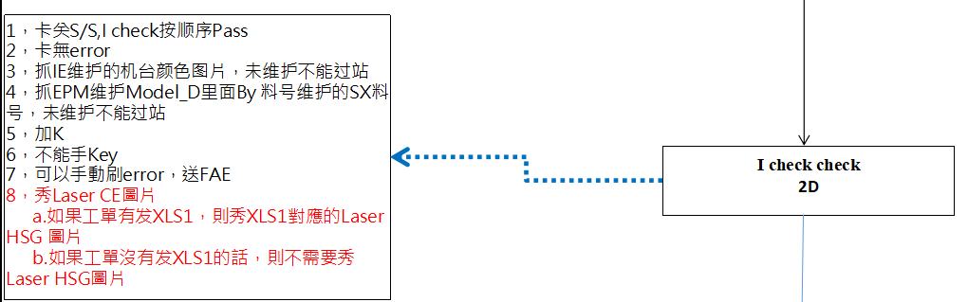
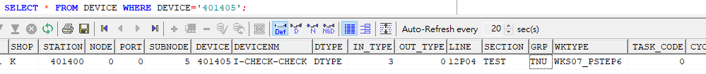
10.I CHECK CHECK（检查I CHECK站位测试是否OK）
(Check if I check station test is OK)
1.GRP: TNU
2.刷法(Brush method)： 2D ISN (DEVICE.INTYPE=3)

Slide 27
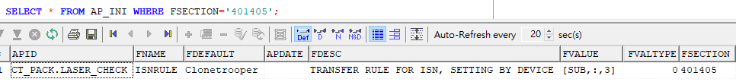
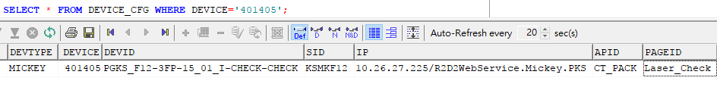
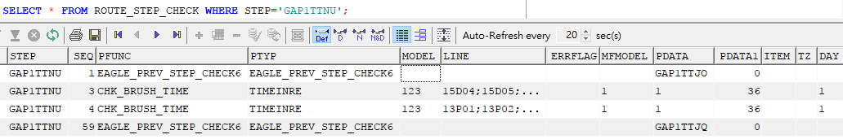
3.站位卡关（Station card off）
SELECT * FROM ROUTE_STEP_CHECK WHERE STEP='GAP1TTNU';

Slide 28
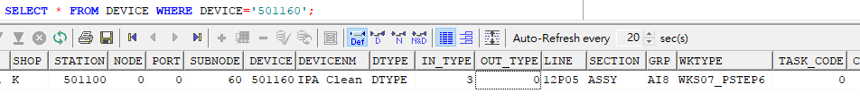
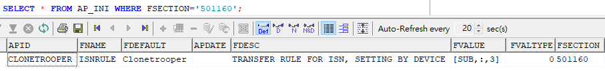
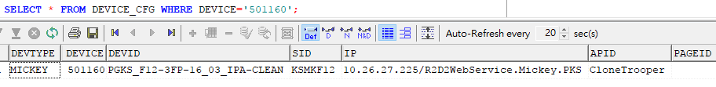
11.IPA Clean
1.GRP: AI8
2.刷法(Brush method)： 2D ISN (DEVICE.INTYPE=3)

Slide 29
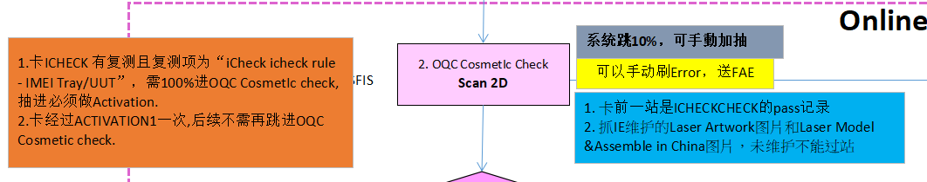
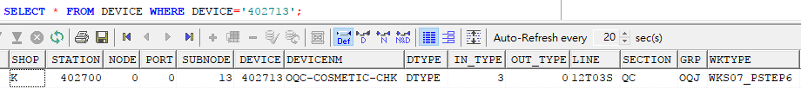
12.OQC COSMETIC CHECK
1.GRP: OQJ
2.刷法(Brush method)： 2D ISN (DEVICE.INTYPE=3)

Slide 30
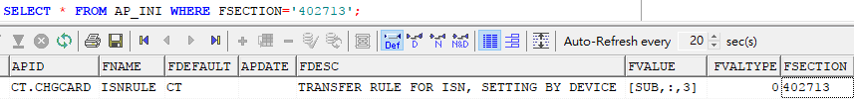
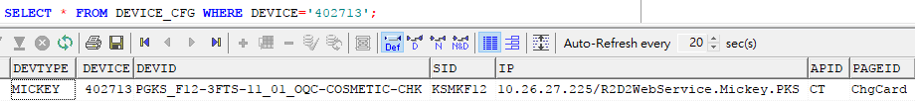
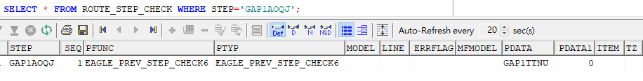
3.站位卡关（Station card off）
SELECT * FROM ROUTE_STEP_CHECK WHERE STEP='GAP1TTNU';

Slide 31
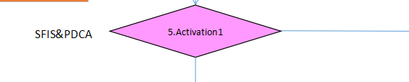
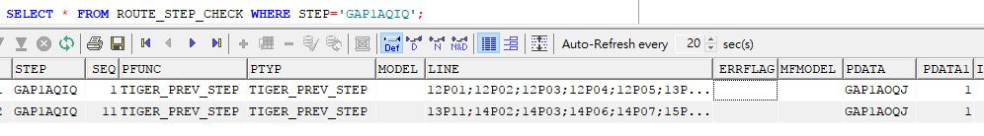
13.ACTIVATION1（测试站）
(TEST STATION)
1.GRP: QIQ
2.站位卡关（Station card off）
SELECT * FROM ROUTE_STEP_CHECK WHERE STEP='GAP1AQIQ';

Slide 32
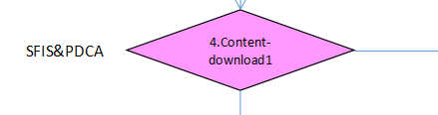
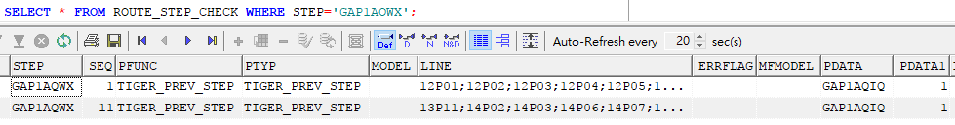
14.CONTENT-DOWNLOAD1（测试站）
(TEST STATION)
1.GRP: QWX
2.站位卡关（Station card off）
SELECT * FROM ROUTE_STEP_CHECK WHERE STEP='GAP1AQWX';

Slide 33


15.OQC SHIPPING SETTING1（测试站）
(TEST STATION)
1.GRP: QI0
2.站位卡关（Station card off）
SELECT * FROM ROUTE_STEP_CHECK WHERE STEP='GAP1AQI0';

Slide 34


16.ICHECK-OQC1（测试站）
(TEST STATION)
1.GRP: QF7
2.站位卡关（Station card off）
SELECT * FROM ROUTE_STEP_CHECK WHERE STEP='GAP1AQF7';

Slide 35


17.OQC ONLINE FUNCTION IN
1.GRP: QIG
2.刷法(Brush method)： 2D ISN (DEVICE.INTYPE=3)

Slide 36



3.站位卡关（Station card off）
SELECT * FROM ROUTE_STEP_CHECK WHERE STEP='GAP1AQIG';

Slide 37


18.OQC ONLINE FUNCTION OUT
1.GRP: QVM
2.刷法(Brush method)： 2D ISN (DEVICE.INTYPE=3)

Slide 38



3.站位卡关（Station card off）
SELECT * FROM ROUTE_STEP_CHECK WHERE STEP='GAP1AQVM';

Slide 39


SELECT * FROM ROUTE_STEP_NSTEP WHERE STEP='GAP1AQVM';
SELECT * FROM ROUTE_STEP_NSTEP_D WHERE STEP='GAP1AQVM';
（PASSQTY表示过站数，TANSQTY表示抽测数，抽测比率为：TANSQTY/PASSQTY，如下图代表抽测比率为100%）
(PASSQTY refers to the number of passing stations, TANSQTY refers to the number of sampling, and the sampling ratio is: TANSQTY / PASSQTY, as shown in the figure below, the sampling ratio is 100%)

Slide 40


Slide 41



Slide 42


Slide 43


Slide 44


Slide 45


Slide 46


19.OQC OFFLINE IN
1.GRP: QVO
2.刷法(Brush method)： 2D ISN (DEVICE.INTYPE=3)

Slide 47



3.站位卡关（Station card off）
SELECT * FROM ROUTE_STEP_CHECK WHERE STEP='GAP1AQVO';

Slide 48


20.OQC CA IN
1.GRP: QVQ
2.刷法(Brush method)： 2D ISN (DEVICE.INTYPE=3)

Slide 49



Slide 50

21.ACTIVATION2（测试站）
(TEST STATION)
1.GRP: QIS

